Slide 1

Tseliso Ramoeletsi
Quantum Analytics – Python Project Supermarket Store 2023

Slide 2
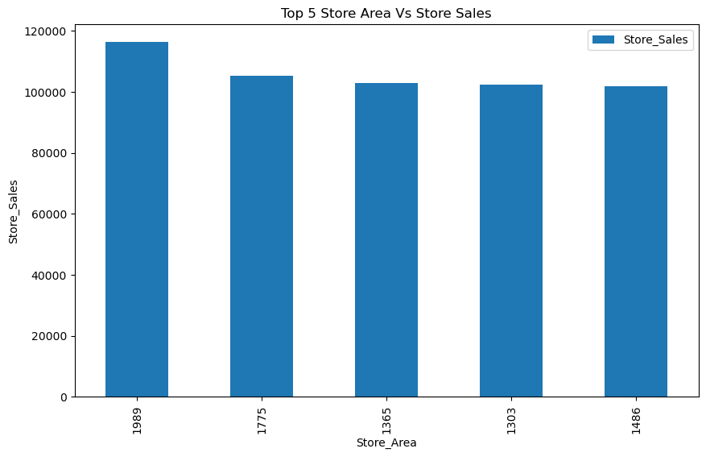
Top 5 Store Area Vs Store Sales

Slide 3
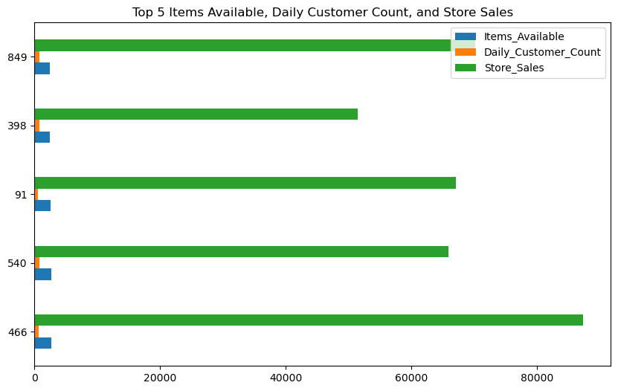
Top 5 Items Available, Daily Customer Count, and Store Sales

Slide 4
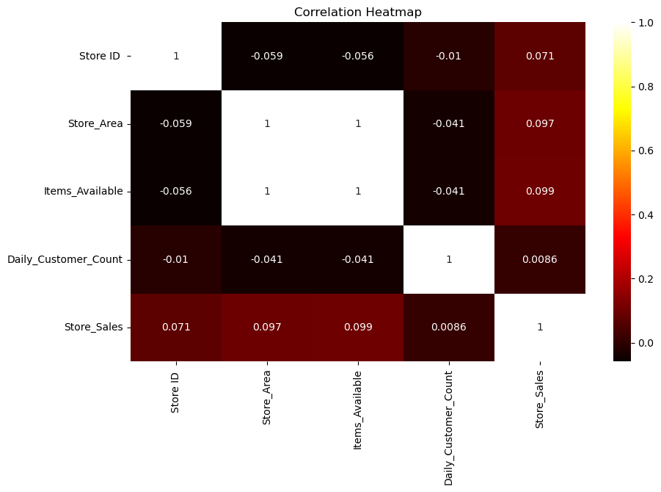
Correlation Heatmap

Slide 5
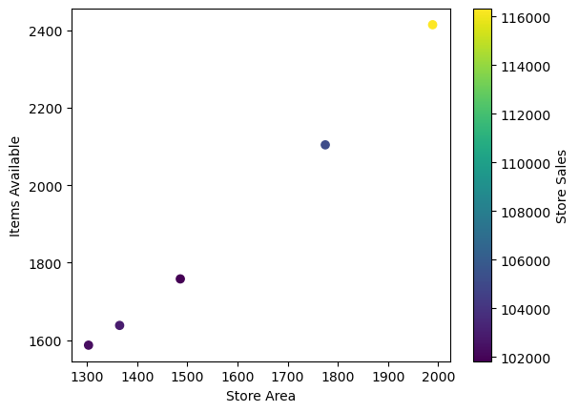
Top 5 Store Areas by Items Available.

Slide 6
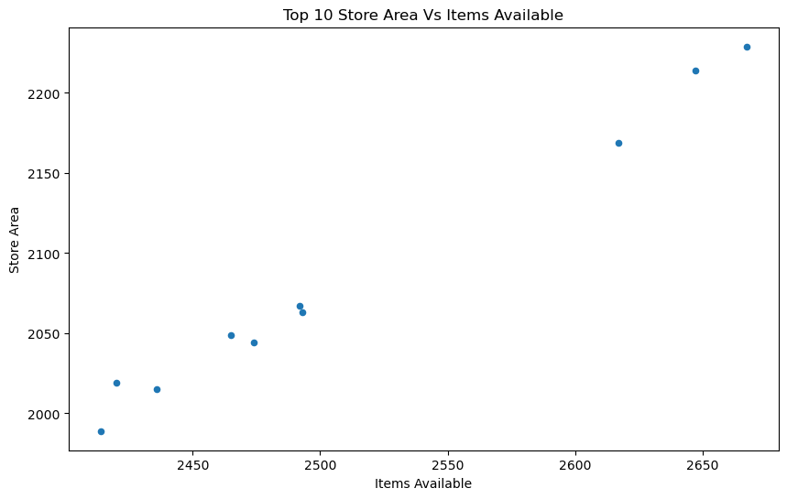
Top 10 Store Area Vs Items Available

